Slide 1
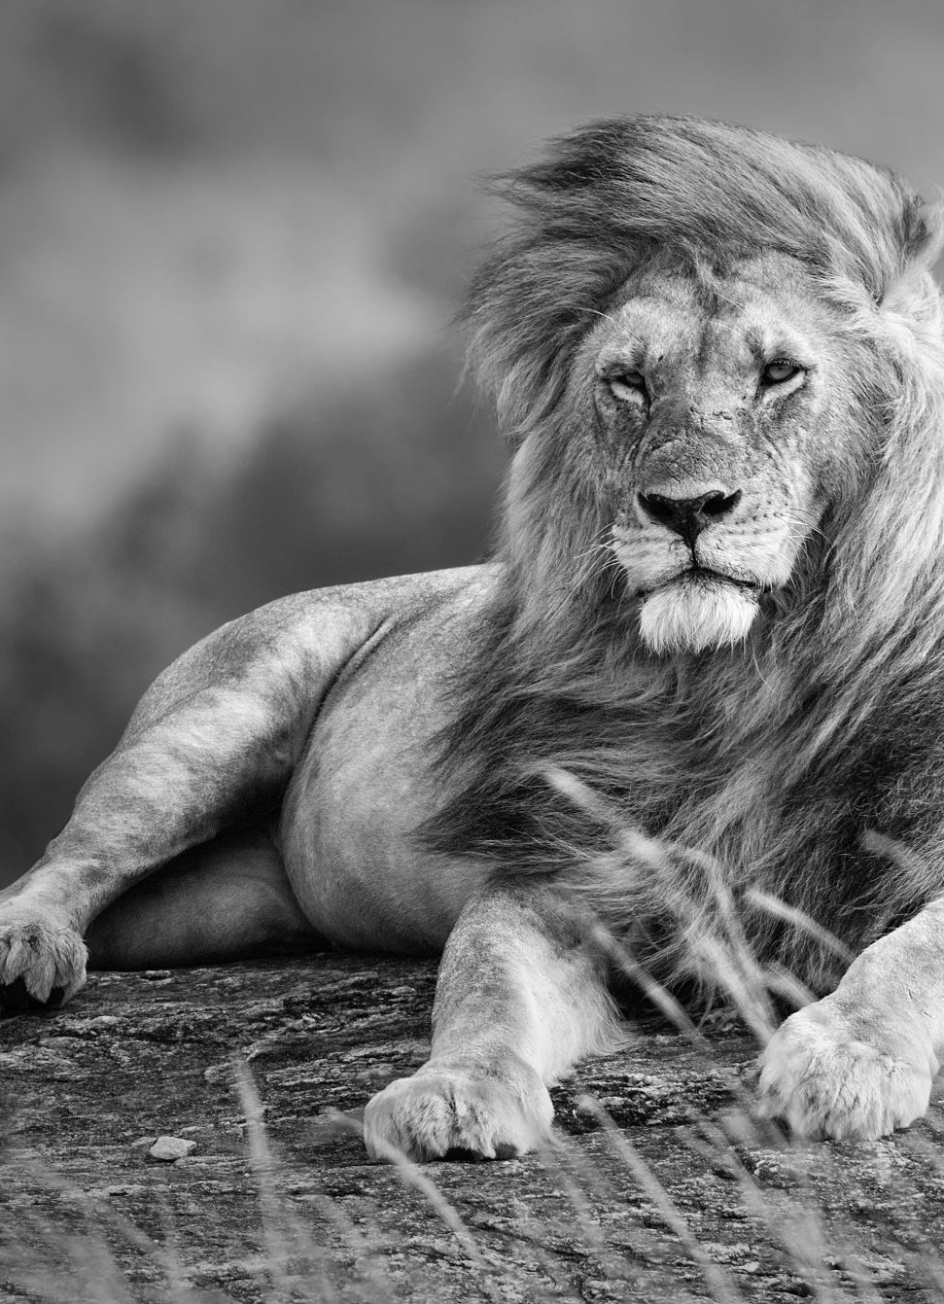
Types of Behaviours
Learning Intention: Understand how prosocial and antisocial behaviours can be developed overtime

Slide 2
What would you do?
You have bought a large trolley load of shopping from Woolworths for your monthly shopping. Once you finish packing your car what do you do with the trolly?

Slide 3
PRO-SOCIAL BEHAVIOUR
‘Helping behaviour’ or intentional ‘acts of kindness’ that benefit others and results in good consequences.
E.g. helping search for a lost dog.
When this behaviour is undertaken without any regard to the health, safety and welfare of the self (Unselfish act) it is known as ‘altruistic behaviours’.
E.g. helping donating money to charity.
Component of pro-social behaviour: EMPATHY
An emotional response to another person’s feelings.
The ability to adopt the perspective of another person.
The ability to understand another person’s emotional state or distress.
Empathy can account for human motivation to help others.

Slide 4
Prosocial Acts
Lists as many prosocial acts that you have done in your life time

Slide 5
Why do people act pro-socially?
INHERITED
It is speculated that the human tendency to help others is innate, instinctive & inborn. In the same way as are the human tendencies to eat, drink and have babies.
It is also speculated that you are more likely to help a family member than a stranger. This biological view only has some support and is not the generally accepted view.

Slide 6
Why do people act pro-socially?
LEARNED
Mainly during childhood! Changes in behaviour can come about through the following:
Reward, praise & reinforcement of prosocial activities like sharing.
Instructing children in being helpful can lead to changes in Behaviour
Allowing children to watch a person engaging in a helpful task - (Modelling behaviour)
Attributing helpfulness to oneself, “I am a helpful person” therefore I can help others.
Helping behaviour is the norm or expectation of our society.

Slide 7
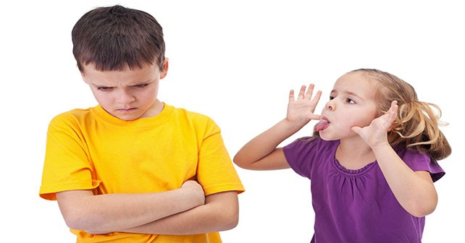
ANTI-SOCIAL BEHAVIOUR
Opposite to pro-social
Voluntary, intentional behaviour designed to hurt/cause distress to another person physically/psychologically.
BULLYING:
A FORM OF AGGRESSIVE BEHAVIOUR DESIGNED TO CAUSE HURT OR DISTRESS TO OTHERS physically, emotionally or mentally.
AN AGGRESSIVE ACT PERPETRATED BY Another person, who is often a MORE POWERFUL PERSON (more powerful does not necessarily refer to physical size).

Slide 8
Why do people act anti-socially?
Can be learned through:
Social norms
Direct teaching of aggression by parents
Observation of aggression in peers and parents
Direct reinforcement

Slide 9
Factors that influence anti-social behaviour
Diffusion of responsibility: when everyone thinks someone else will act. The more people present, the less likely you are to help.
Audience inhibition: presence of others can make you feel self conscious and scared of making a social blunder.
Social influence: more likely to act if your role models or high ranking peers do.
“If no one else is doing anything, then why should I?”
Cost benefit analysis: you calculate what you will gain vs. what you will lose if you get involved.

